Slide 1
CatEats App
Vicky Raghoebier

Slide 2
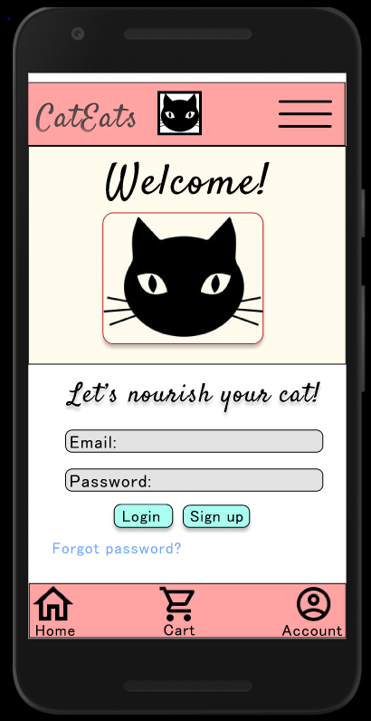
Project overview
The product:
CatEats is a modernized app that saves time and effort in purchasing cat food. It offers variety for different feline breeds and is essential for a busy cat owner who needs consistent deliveries.
Project duration:
October 2021- January 2022

Slide 3
Project overview
The problem:
Busy cat owners lack the time and convenience to search for the right food option for their pet
The goal:
Create an app that caters to cat owners, allowing them to quickly order healthy and breed specific cat food and get it delivered at the doorstep.

Slide 4
Project overview
My role:
Design an app for CatEats App from conception to delivery
Responsibilities:
Conducting interviews, paper and digital wireframing, low and high-fidelity prototyping conducting usability studies, accounting for accessibility, and iterating on designs.

Slide 5
User research
Personas
Problem statements
User journey maps
Understanding
the user

Slide 6
User research: summary
After conducting interviews and creating empathy maps I focused on the needs of the users and starting designing based on those findings.
The primary user group identified were working adults between 21-60 who were in small households. Apart from being busy with work there were other factors limiting users from getting food for their cat quickly, including challenges to make it to the grocery store, difficulties interacting with existing websites and apps, and being busy taking care of other family members.

Slide 7
User research: pain points
1
2
3
4
Time
Accessibility
Options
Tracking
Working adults have no time to spend on pet store and grocery store visits
Existing platforms offering cat food are not equipped with assistive technologies
Existing platforms don’t provide legible labels and there is no option to filter search results
It takes a long time for the food to be delivered along with having rough delivery time estimates.

Slide 8
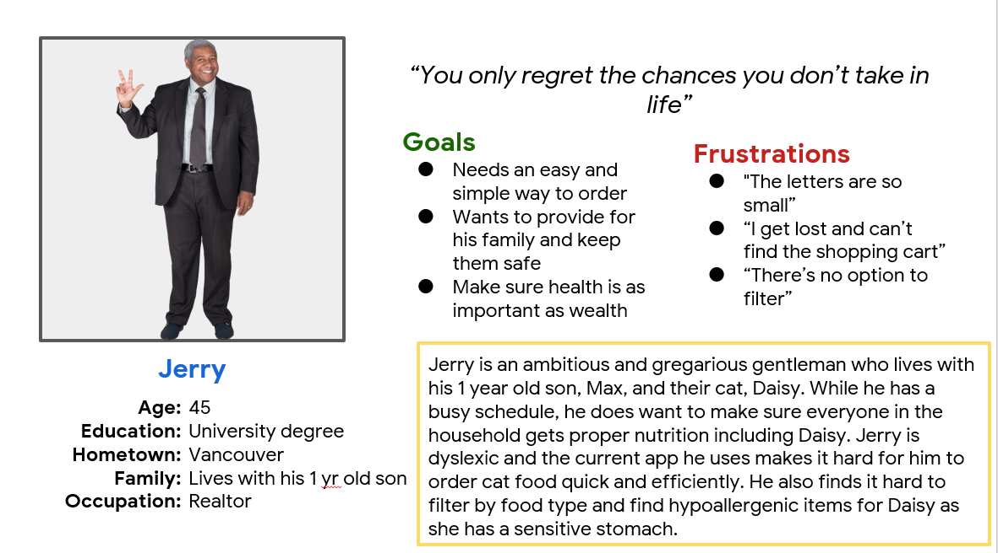
Persona: Jerry
Problem statement:
Jerry is a busy single dad
who needs access to cat food ordering options because he has no time to visit the pet store.

Slide 9
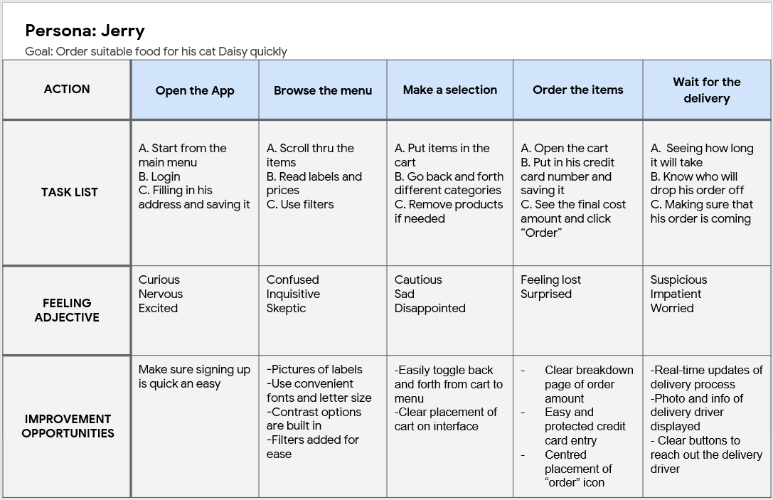
User journey map
Mapping Jerry’s journey was essential to discover and empathize with his challenges at every step.
Image of user journey map

Slide 10
Paper wireframes
Digital wireframes
Low-fidelity prototype
Usability studies
Starting
the design

Slide 11
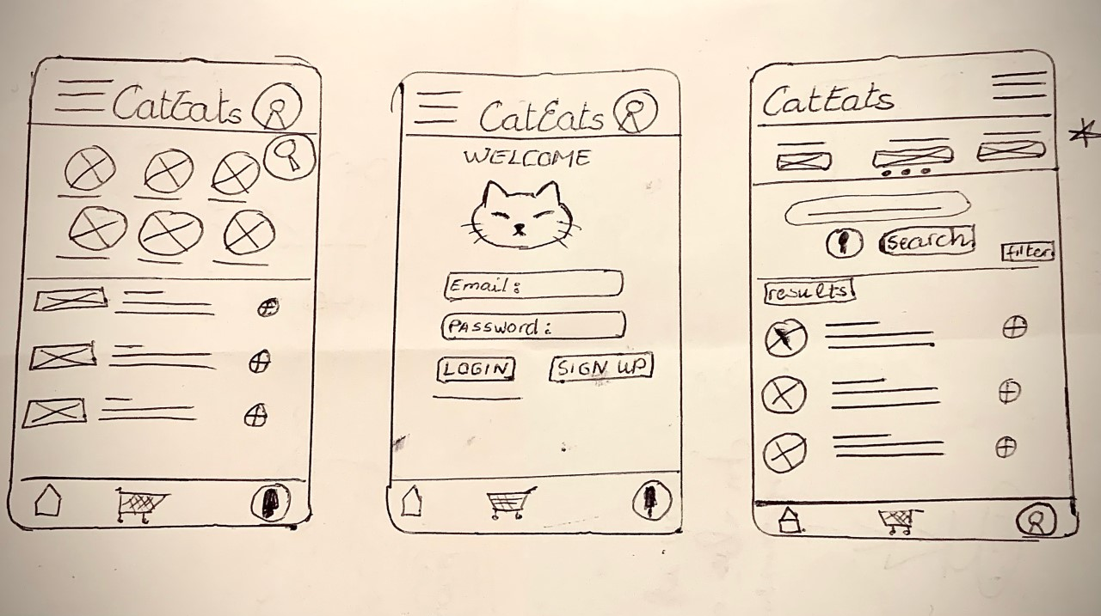
Paper wireframes
The goal with the paper wireframes was to come up with inclusive designs that would serve the users well. I focused on creating intuitive designs to save users time.
Image of paper wireframes including five different versions of the same screen and one image of the new, refined version

Slide 12
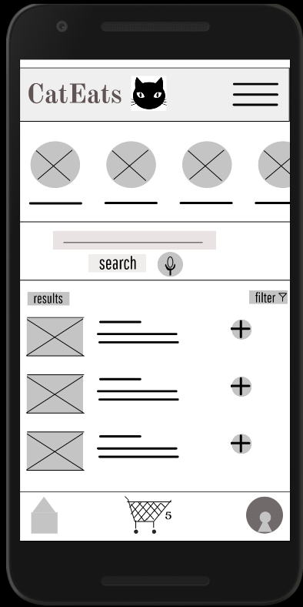
Digital wireframes
As the initial design phase continued, I made sure to base screen designs on feedback and findings from the user research.
Voice search to assist users
Filter to narrow down products and save time

Slide 13
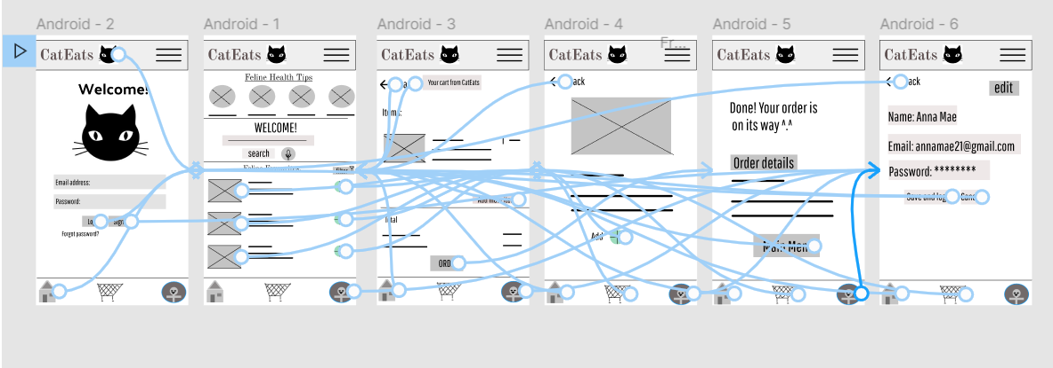
Low-fidelity prototype
Using the completed set of digital wireframes, I created a low-fidelity prototype. The primary user flow I connected was logging in and ordering cat food, so the prototype could be used in a usability study.
Screenshot of prototype with connections or prototype GIF
View CatEats App’s low-fidelity prototype

Slide 14
Usability study: findings
I conducted two rounds of usability studies. Findings from the first study helped guide the designs from wireframes to mockups. The second study used a high-fidelity prototype and revealed what aspects of the mockups needed refining.
Round 1 findings
Round 2 findings
1
Users want the ability to navigate the app without a profile.
1
Users want to see a confirmation page once they’re logged in.
2
Users find top bar not intuitive
3
Users are confused with the profile icon

Slide 15
Refining
the design
Mockups
High-fidelity prototype
Accessibility

Slide 16
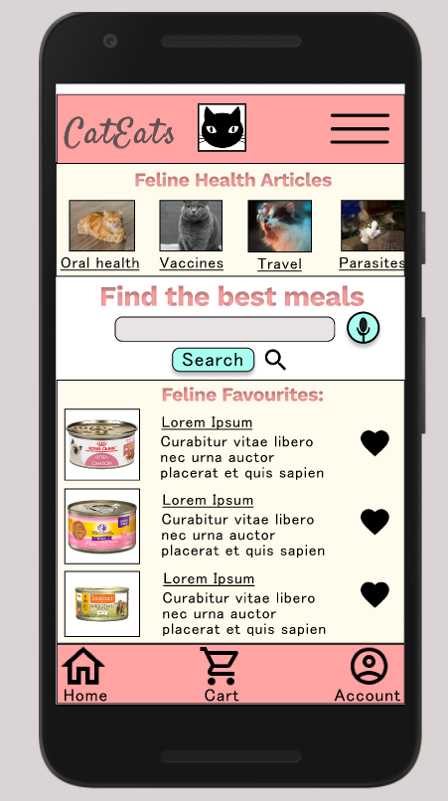
Before usability study
After usability study
Mockups
Early designs allowed for some customization, but after the usability studies I revised the design, so users know what the top bar represents and can recognize the profile icon now.

Slide 17
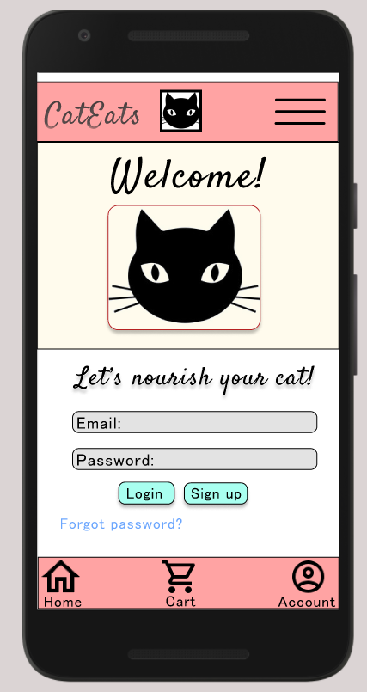
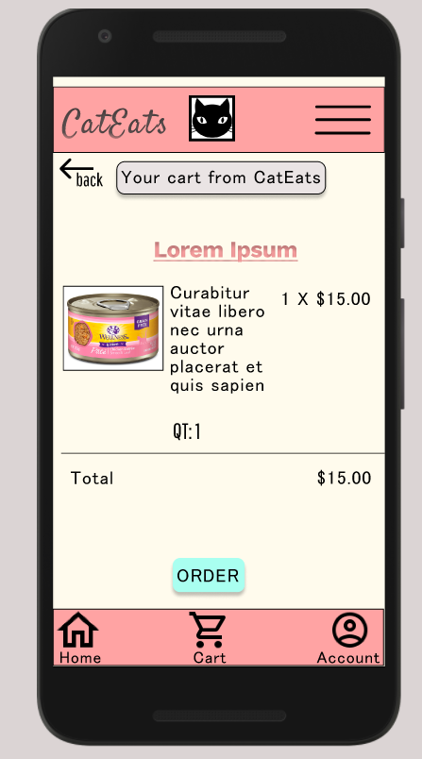
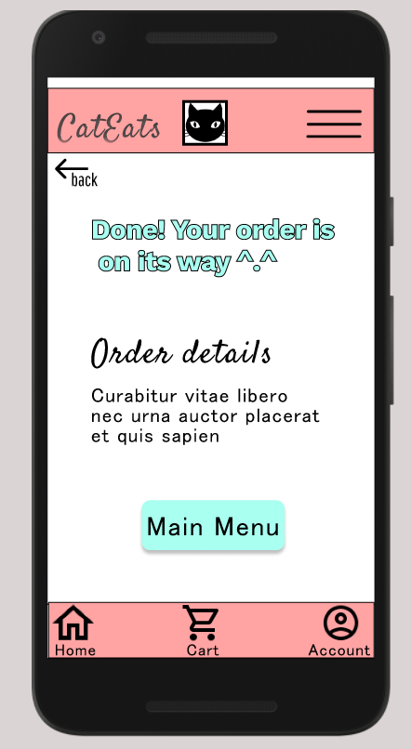
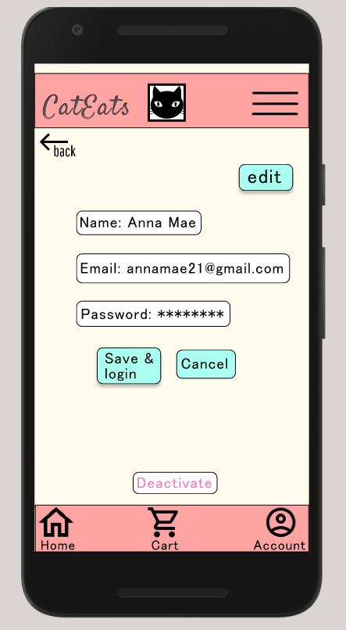
Key Mockups
Main mockup screen for display
Main mockup screen for display
Main mockup screen for display
Main mockup screen for display

Slide 18
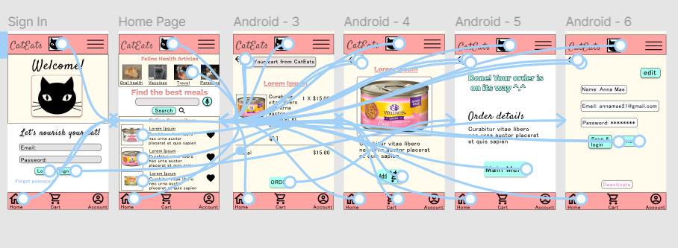
High-fidelity prototype
The final high-fidelity prototype presented cleaner user flows for ordering cat food and checkout.
View CatEats App’s high-fidelity prototype

Slide 19
Accessibility considerations
1
2
3
Provided voice search and screen reader options for visually impaired users
Used icons to help make navigation easier.
Added detailed descriptions and label images of cat foods to make selection process easier

Slide 20
Going forward
Takeaways
Next steps

Slide 21
Takeaways
Impact:
CatEats App makes users feel happy and carefree.
What I learned:
In creating CatEats app I’ve learned that impactful and inclusive design is only possible after thorough research and user feedback.

Slide 22
Next steps
1
2
Conduct another round of usability studies to validate whether the pain points users experienced have been effectively addressed.
Add more features based on user needs

Slide 23
Insert a few sentences summarizing the next steps you would take with this project and why. Feel free to organize next steps in a bullet point list.
Let’s connect!
Thank you for your time reviewing my work on the CatEats App! If you’d like to
see more or get in touch, my contact information is provided below.
Email: virag2017@email.com

Slide 24
Thank you!

